Slide 1
Introduction to Arduino & Microcontroller Programming
Coding Bootcamp @ Belkin
Apr-2019

Slide 2

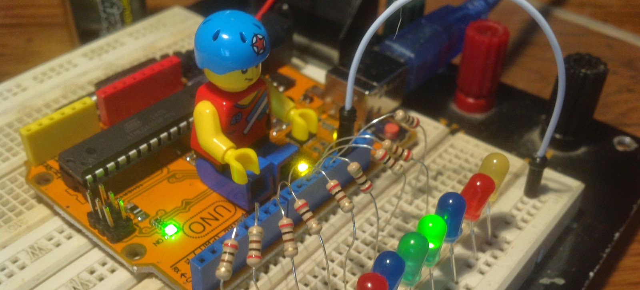
What is Arduino?
A microcontroller board ( a small single chip computer )
A USB connection for programming and basic communication
Has a number of connections that can be wired to external electronics for gathering data or control (GPIO).
User friendly opensource hardware, software, and tools designed for learning programming and electronics

Slide 3
Meet Arduino Uno

Slide 4
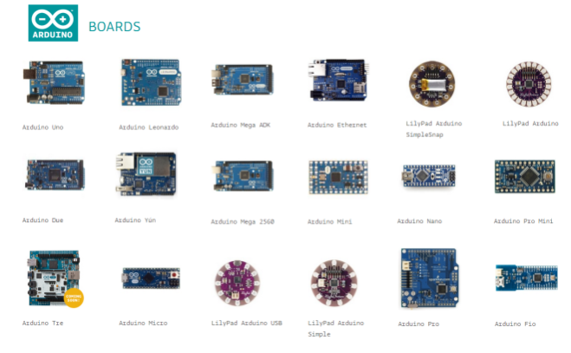
Something for Everyone
There are over 800 Arduino compatible boards that can be programmed with the Arduino IDE
There are several hundred 'shield', or daughter boards for adding additional functionality
There are countless free code examples and tutorials online for programming these devices

Slide 5
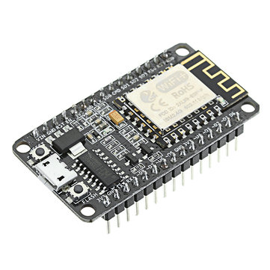
NodeMCU
Arduino compatible development board with built in 2.4Ghz Wifi
C/C++ or Lua programming environment
"Bread board friendly"
An open source IOT platform
Low cost

Slide 6
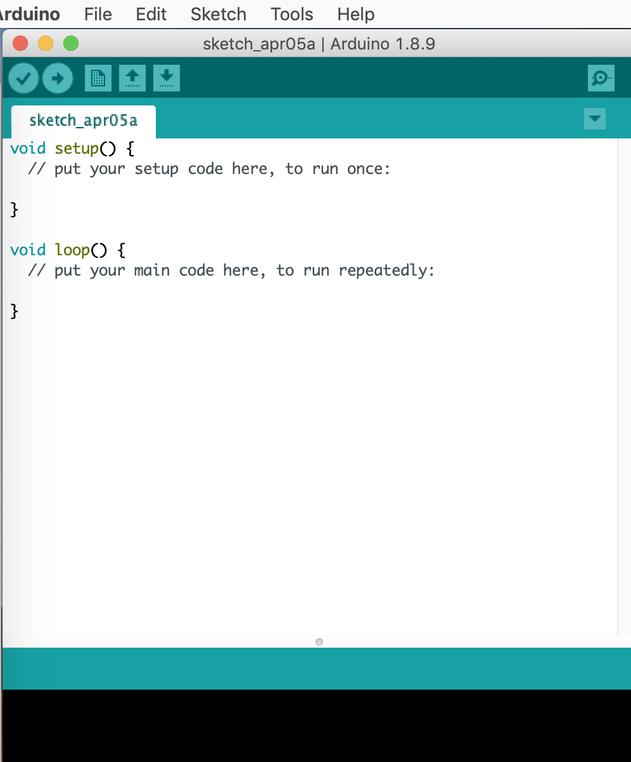
Arduino development environment

Slide 7
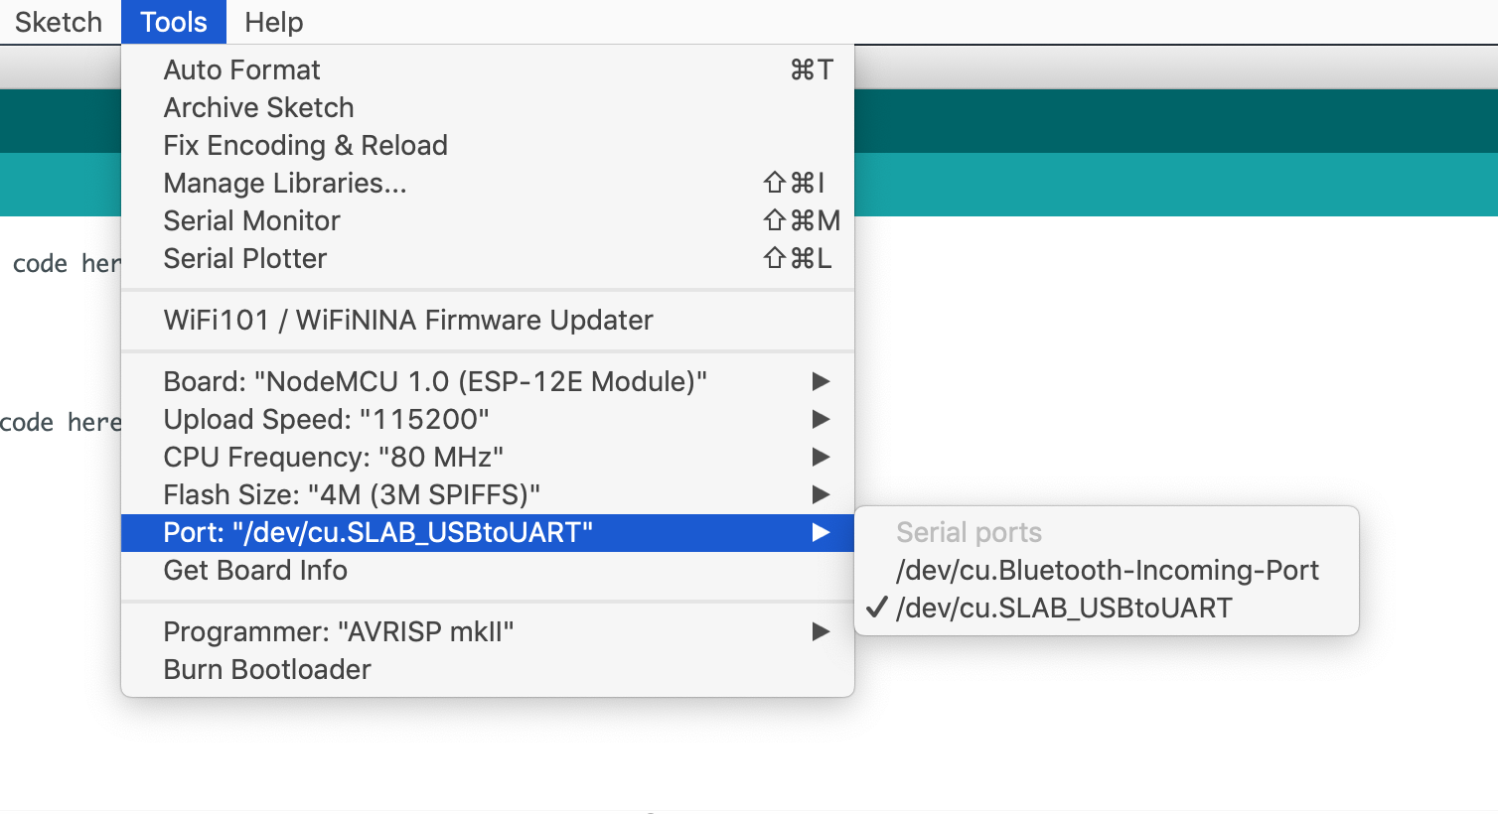
Select Serial Port and Board

Slide 8
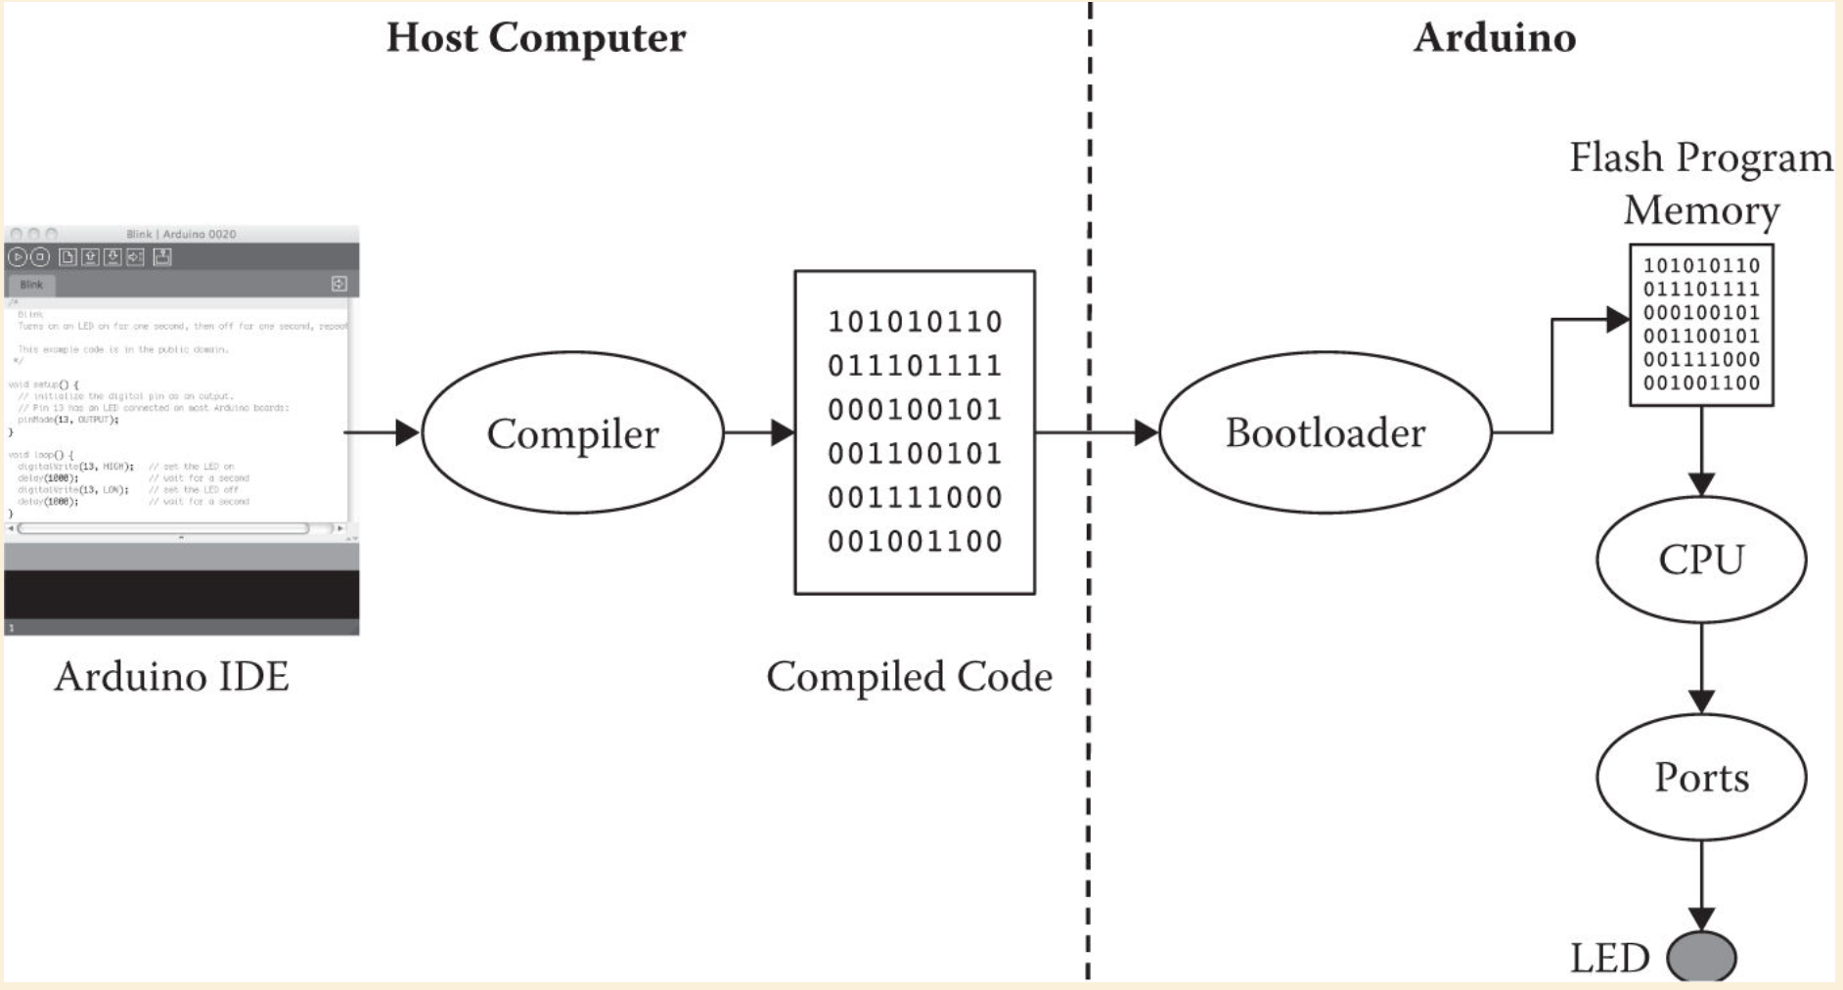

Slide 9
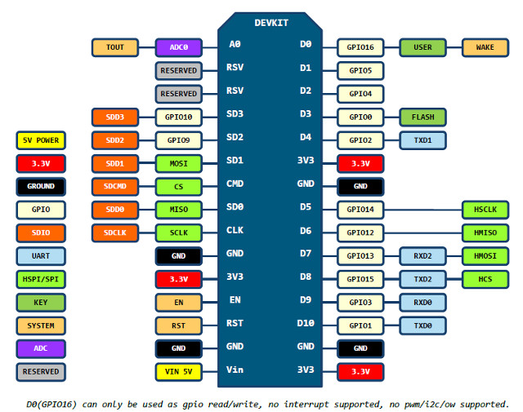
NodeMCU Pinout

Slide 10
Projects Overview
#1. Blink LED
#2. Serial Communication
#3. Setting a simple HTTP web server
#4. Creating a WiFi / Web Controlled LED
#5. Prototyping IoT with ESP8266 and IFTTT

Slide 11
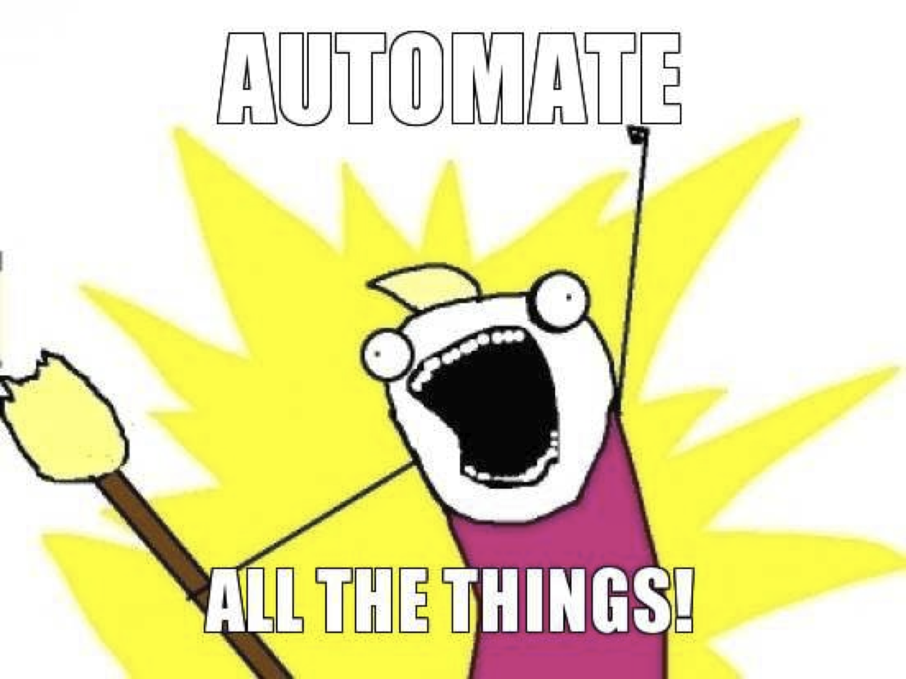
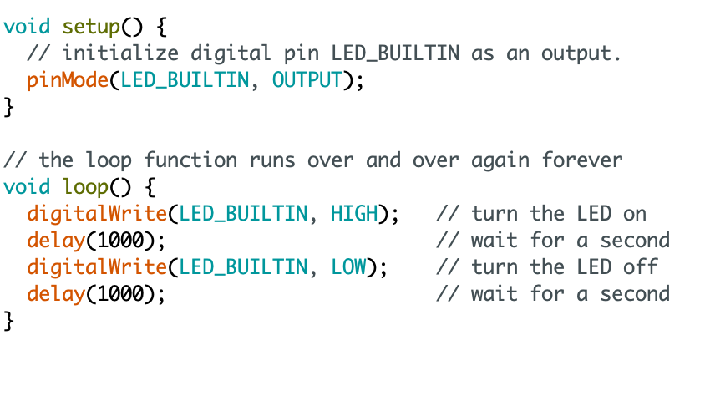
Our First Program
https://github.com/SophiaBelkin/BelkinCodingBootcamp/blob/master/examples/blinkLED/BlinkLED.ino
Notes:
Blink Example

Slide 12
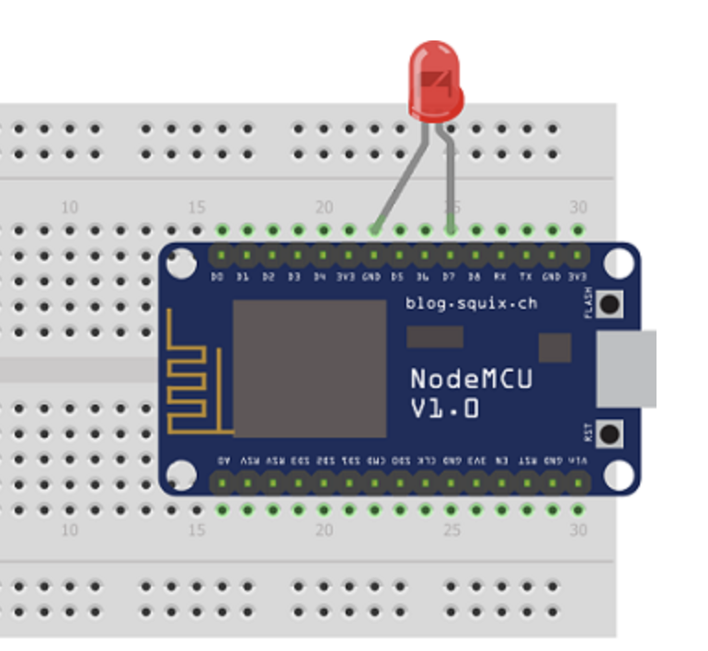
Circuit

Slide 13
Basic C/C++ Embedded programming terms
Variable: Variables are the parts of the program used to hold different values. Similar to X, Y, and other letters In algebra problems
Loop: Loops are repeating sections of code, that may stop if certain criteria are met
VCC/+, GND/-: In electronics these are used to indicate the positive, and negative voltage and will show how current should flow through the electronics
Input / Output: The way that a computer receives or sends bits of information
GPIO/IO pins: General purpose input output pins can be used as input or output devices, and can be turned on or off, or can detect if a connected signal is turned on or off
Function: A function is a defined set of instructions that can be reused in a program without the programmer repeating the same instructions
Library: A collection of functions typically designed to specialize at some specific task

Slide 14
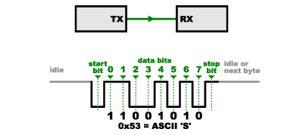
#2 Serial Communication
Serial.begin(9600)
Serial.print() or Serial.println()
Notes:
Probably only be able to explain the first two bullet points
-Explain what the '9600' means
Sets the data rate in bits per second (baud) for serial data transmission

Slide 15

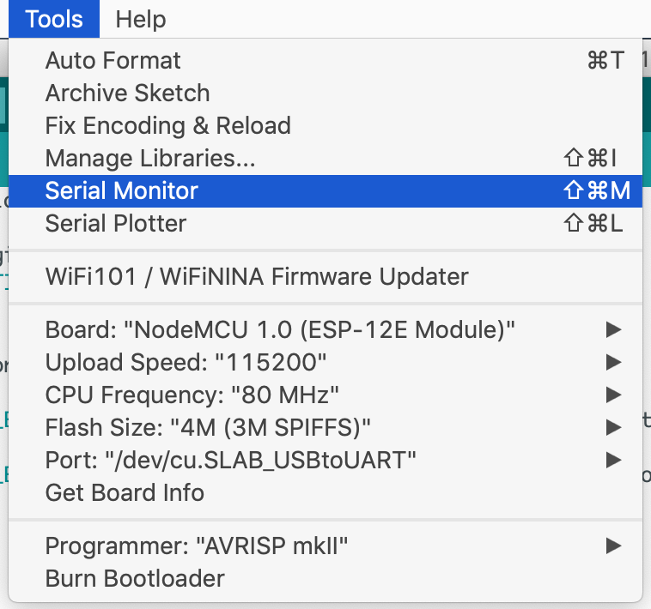
Serial Monitor

Slide 16
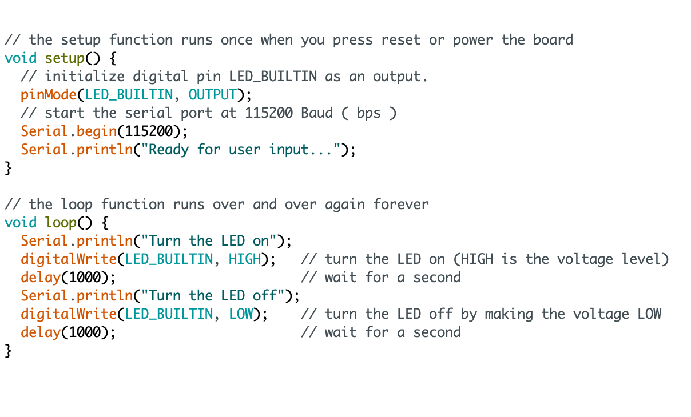
https://github.com/SophiaBelkin/BelkinCodingBootcamp/blob/master/examples/CommunicationSerial/CommunicationSerial.ino

Slide 17
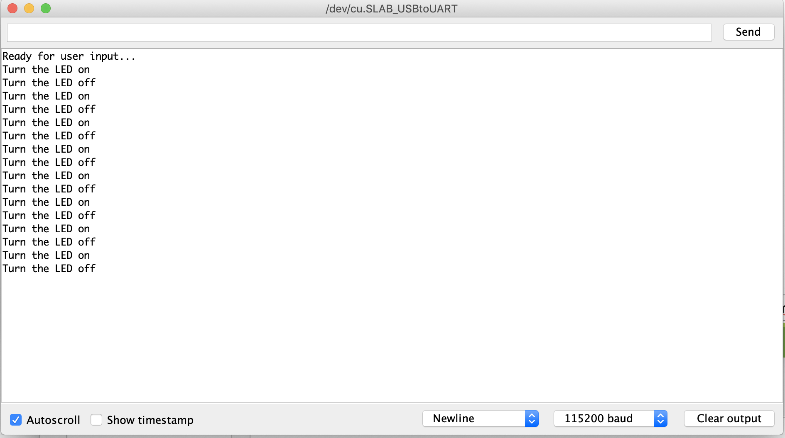
Serial Monitor
https://github.com/SophiaBelkin/BelkinCodingBootcamp/blob/master/examples/CommunicationSerial/CommunicationSerial.ino

Slide 18
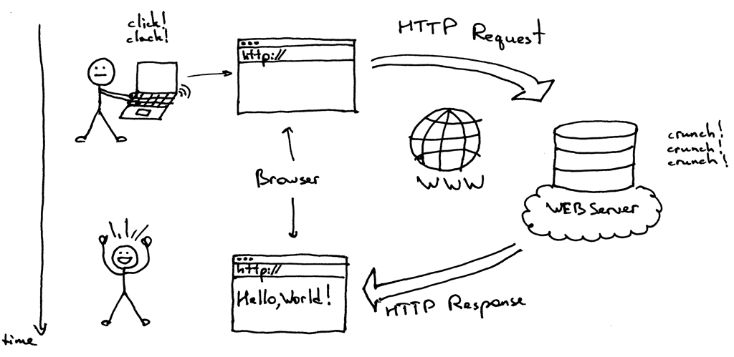
How does the Internet work ( Clients and Servers )
TCP/IP – A set of protocols for sending and receiving data using packets and addresses
Client – A program that ‘connects’ to servers to start communication web browsers are a client program
Server – A program that ‘accepts’ connections from client programs web servers handle connections from a web browser
Notes:
When you enter a url into your browser, the browser looks up the IP address for the domain name via dns. DNS means domain name server, it’s like an address book for websites.
After finding out the correct IP address, the browser initiates a TCP connection with the server. There are other types of protocols but TCP is most common poetical for any type of HTTP request. Once TCP connection is established, the browser sends a Get request to the web server and ask for the webpage The server handles the request and sends back a response. In the server there are programs written in different languages processes the requests and generates the response. After the the response is generated. The server send the response for example a html file back to the browser and the browser would srtart to render it.

Slide 19
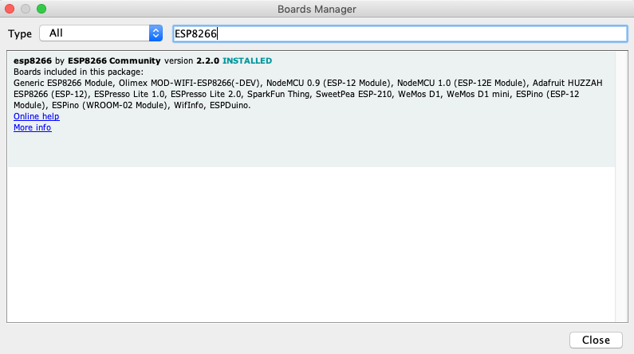
#3 Setting a simple HTTP web server
Step 1: Configure the Arduino IDE to support the ESP8266
https://github.com/SophiaBelkin/BelkinCodingBootcamp/blob/master/examples/ESP8266Server/ESP8266Server.ino

Slide 20
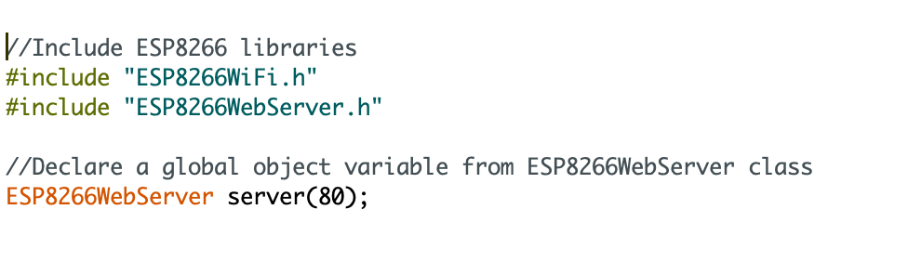
Step 3: Declare a global object variable from ESP8266WebServer class
Step 2: Include ESP8266WiFi and ESP8266WebServer libraries
https://github.com/SophiaBelkin/BelkinCodingBootcamp/blob/master/examples/ESP8266Server/ESP8266Server.ino
Notes:
Include the ESP8266WiFi, ESP8266WebServer library, which will make the class ESP8266WebServer available.
Declare a global object variable from the previously mentioned class, so we will be able to access it in our functions.

Slide 21
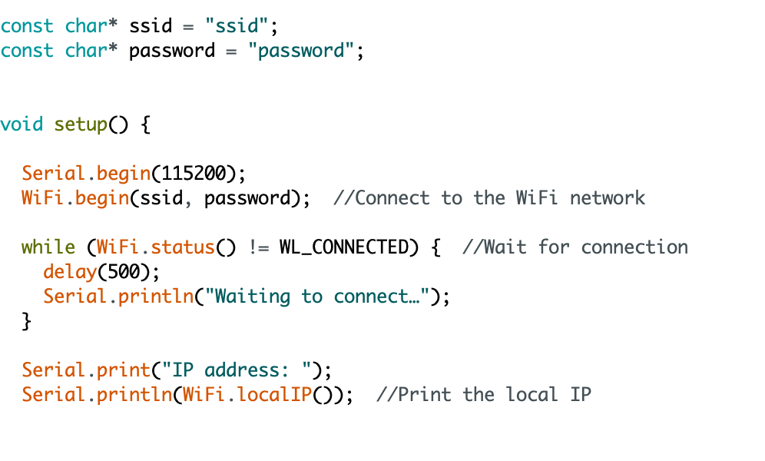
Step 4: Connect to the WiFi network with ESP8266
Step 5 : Get local IP address
https://github.com/SophiaBelkin/BelkinCodingBootcamp/blob/master/examples/ESP8266Server/ESP8266Server.ino

Slide 22
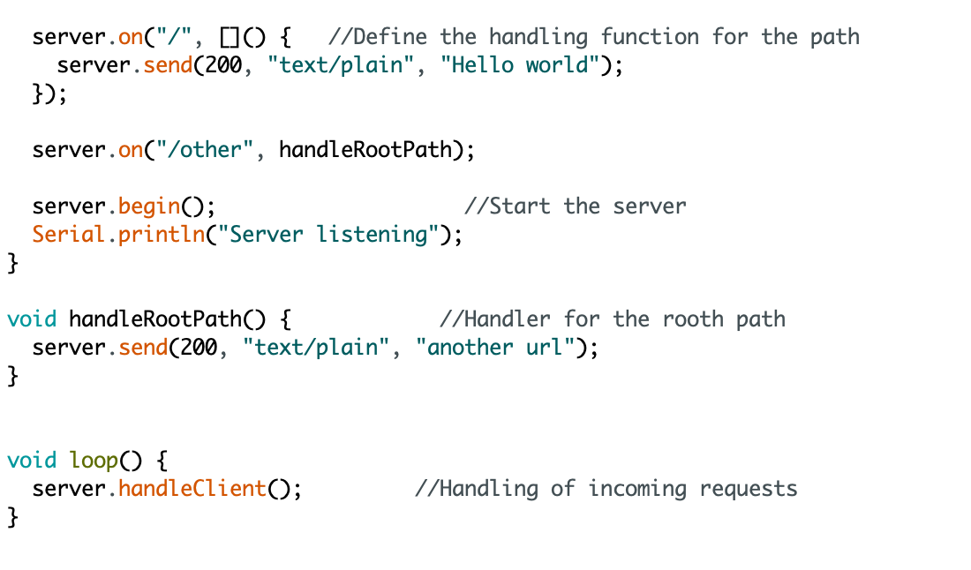
Step 6: Specify the code to be execute when an HTTP request is performed on each path
Step 7: Handle the actual incoming of HTTP requests
https://github.com/SophiaBelkin/BelkinCodingBootcamp/blob/master/examples/ESP8266Server/ESP8266Server.ino

Slide 23
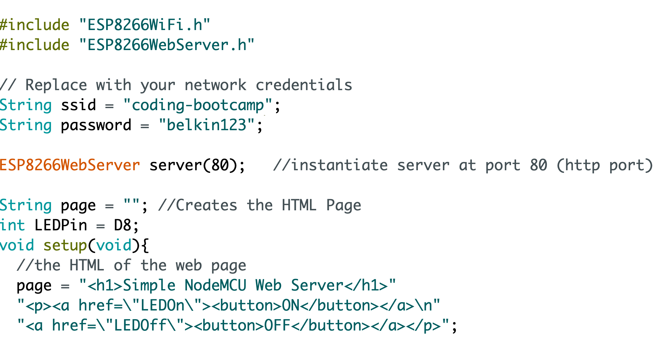
#4 Creating a WiFi / Web Controlled LED
Assign LED pin number and create the HTML page
https://github.com/SophiaBelkin/BelkinCodingBootcamp/blob/master/examples/WifiControledLED/WifiControledLED.ino

Slide 24
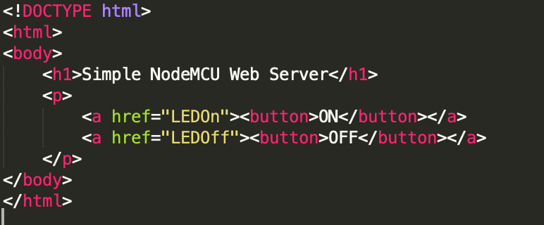
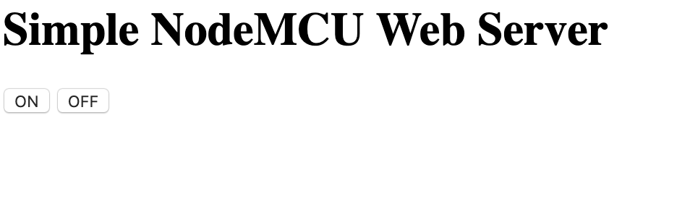

What is HTML?
HTML stands for Hyper Text Markup Language
It describes the structure of a webpage.
HTML element are represented by tags

Slide 25
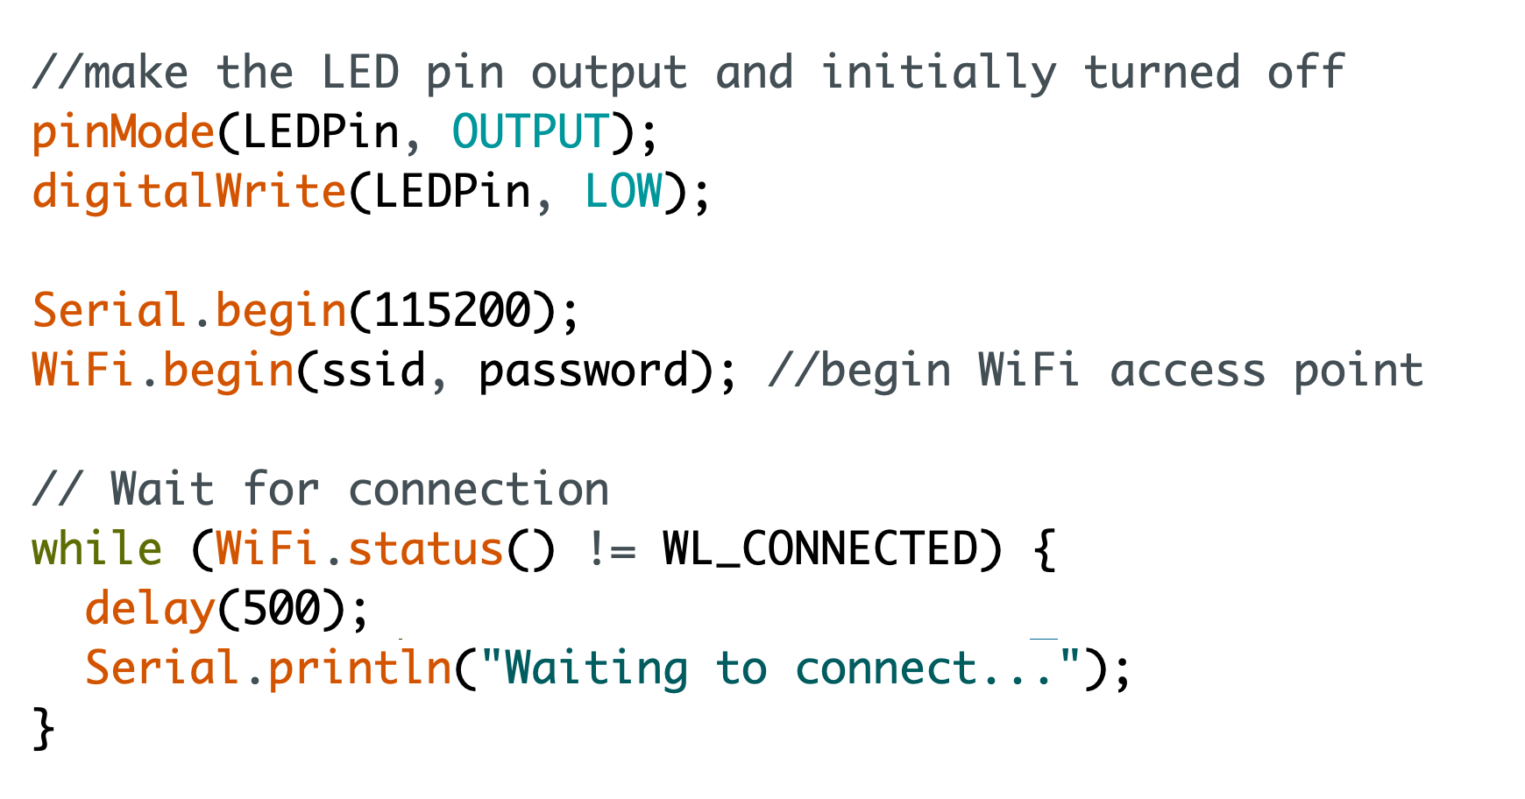
https://github.com/SophiaBelkin/BelkinCodingBootcamp/blob/master/examples/WifiControledLED/WifiControledLED.ino

Slide 26
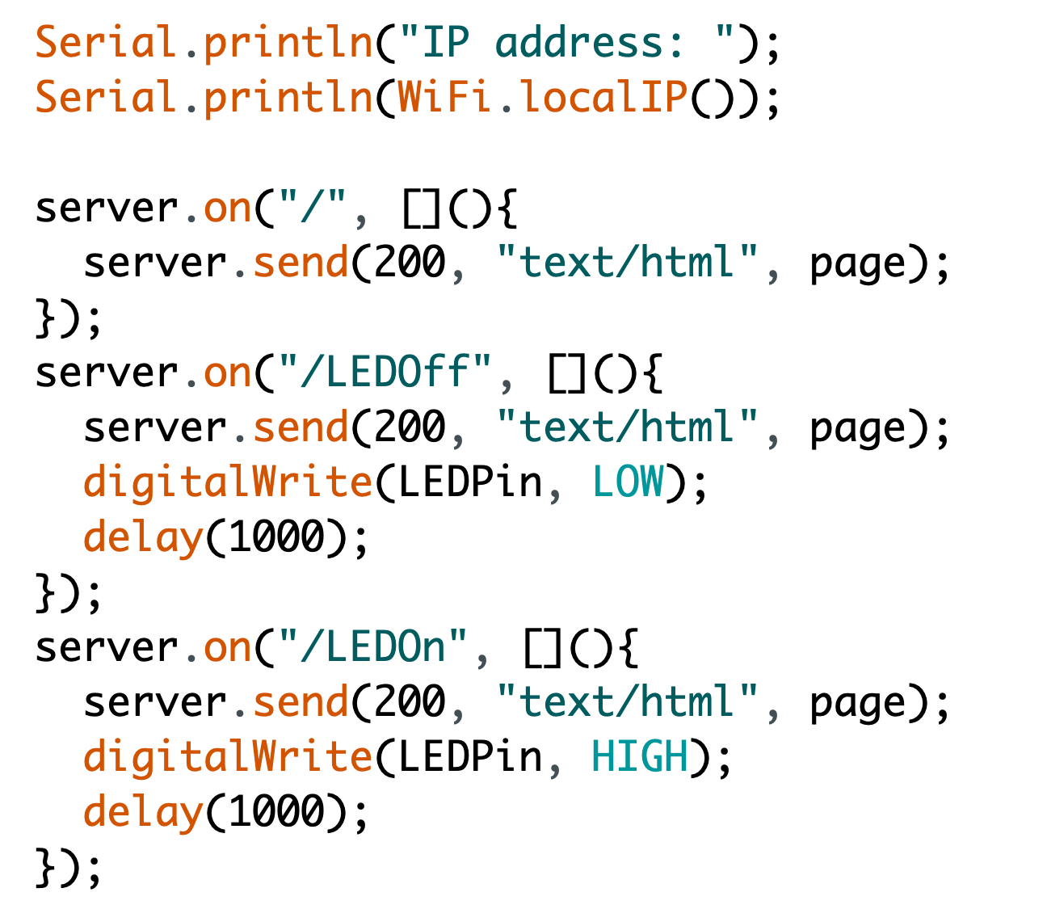
Specify which code to execute when an HTTP request is performed to each path.
https://github.com/SophiaBelkin/BelkinCodingBootcamp/blob/master/examples/WifiControledLED/WifiControledLED.ino

Slide 27
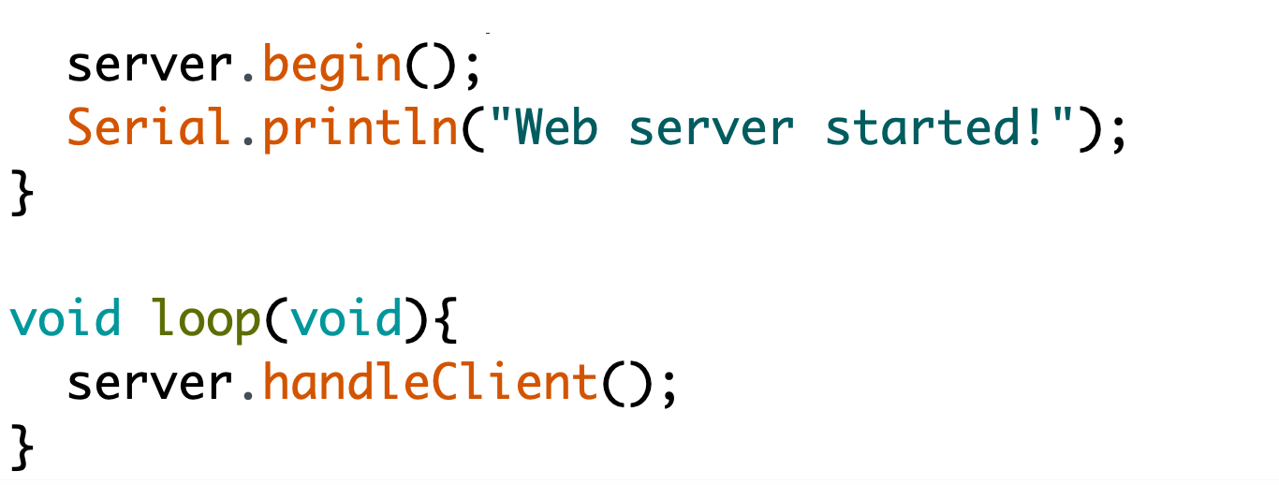
Start our server and handle the incoming http request

Slide 28

#5 Prototyping IoT with ESP8266 and IFTTT
Free platform that lets you create connection between different web-service and applications
Stands for ‘If this, then that’
A combination of a TRIGGER and an ACTION
Examples:
If the sensor is triggered, send me a message
If the garage door is opened, turn the living room lights on

Slide 29
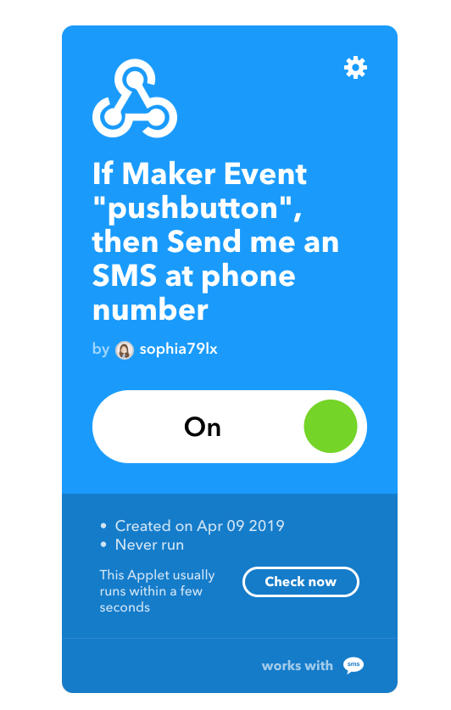

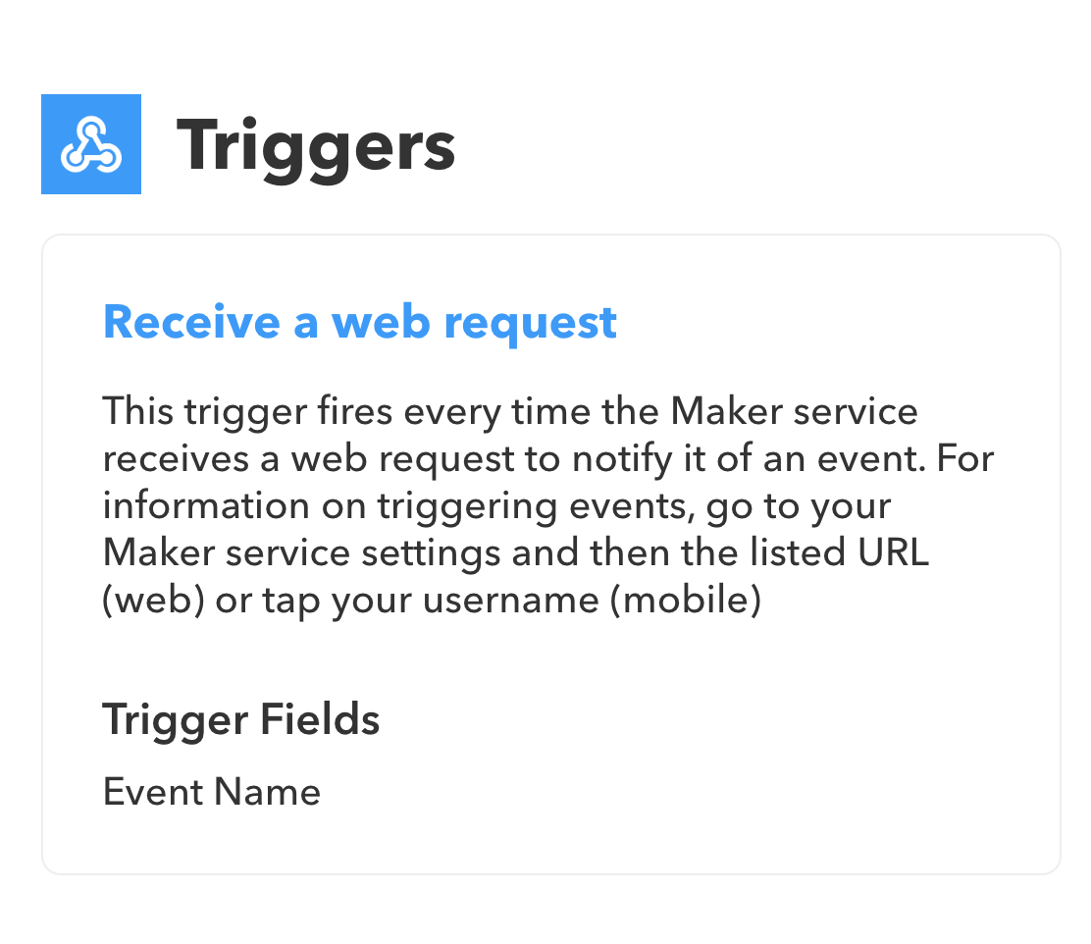
Step 1 Create an account on https://ifttt.com/
Step 2 Create an IFTTT Webhook

Slide 30
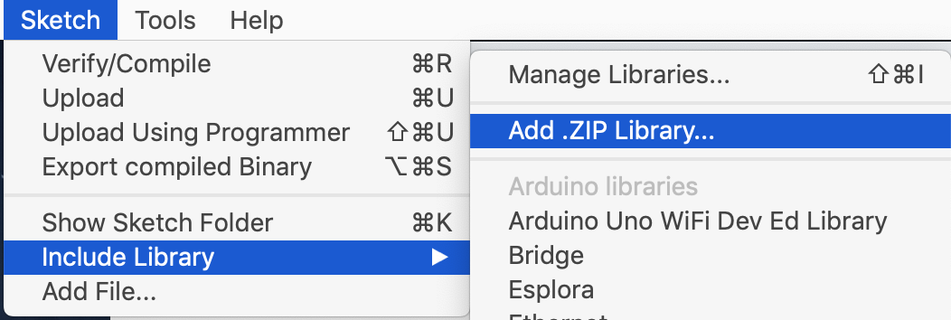
Step 4: Add ESP8266IFTTT to your Arduino libraries
Download the ESP8266IFTTT library from https://github.com/SophiaBelkin/ESP8266IFTTT

Slide 31
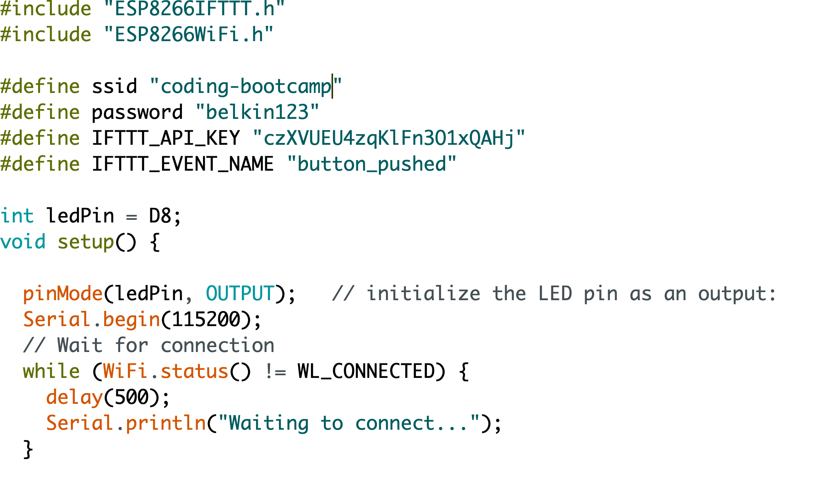
Step 5 Connect to Wi-Fi

Slide 32
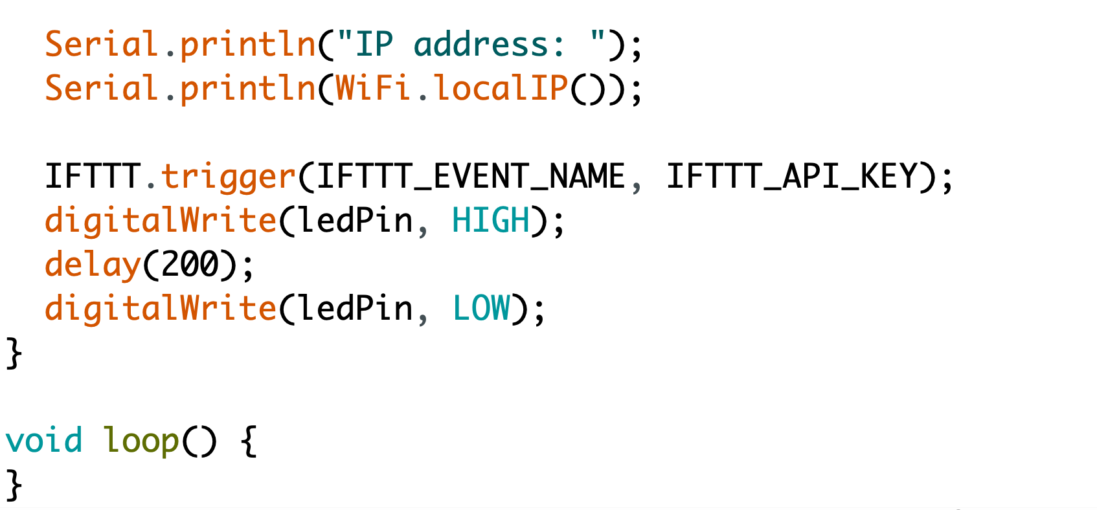
Step 6 Set up IFTTT integration

Slide 33
Glossary
Analog: An input or output that can send or receive a range of values
Digital: An input our output that can send or receive a value of 0 or 1 ( LOW, and HIGH )
Function: A defined section of code that executes a specific task.
Ground: The point of a circuit where there is 0 potential electrical energy. Without a ground, electricity will not have a place to flow in a circuit.
Serial monitor : A tool used to communicate with the Arduino board via the USB Serial port.

Slide 34
Links
https://www.arduino.cc/en/Main/Software - The official Arduino IDE
https://www.makerspaces.com/arduino-uno-tutorial-beginners/ - Arduino Beginner tutorial(s)
https://www.makeuseof.com/tag/getting-started-with-arduino-a-beginners-guide/
https://www.arduino.cc/en/tutorial/links - More Arduino programming links
http://www.oddwires.com/arduino-project-ideas/ - Arduino Project Ideas
https://www.hackster.io/Aritro/getting-started-with-esp-nodemcu-using-arduinoide-aa7267
https://github.com/SophiaBelkin/BelkinCodingBootcamp

Slide 35
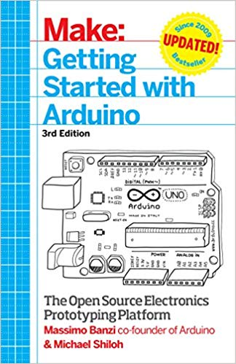
Further Reading
For Absolute Begineers
Getting Started with Arduino: The Open Source Electronics Prototyping Platform
by Massimo Banzi , Michael Shiloh
This is a beginner friendly book written based on the platforms's cofounder Massimo Banzi's expensive experience in teaching, using and building Ardunio

Slide 36
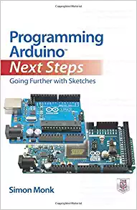
Further Reading
Take your skill to the next level
Programming Arduino Next Steps: Going Further with Sketches
by Simon Monk
Learn advanced Arduino programming techniques, including how to:
Program Arduino for the Internet
Maximizing serial communications
Managing memory
Performing dinital signal processing
Create and release your own code library

Slide 37

Further Reading
Take your skill to the next level
Electronics from the Ground Up: Learn by Hacking, Designing, and Inventing
by Ronald Quan
Guides you through step-by-step experiments that reveal how electronic circuits function.

Slide 38

Further Reading
Fun project ideas
Arduino Workshop: A Hands-On Introduction with 65 Projects
by John Boxall
Among the book's 65 projects are useful devices like:
A digital thermometer that charts temperature changes on an LCD
A GPS logger that records data from your travels, which can be displayed on Google Maps
A handy tester that lets you check the voltage of any single-cell battery
A keypad-controlled lock that requires a secret code to open

Slide 39

Further Reading
All about circuits and electrical components
Make:
Electronics
by Charles Platt
"Burn things out, mess things up-that's how you learn".
Learn about common electronic components
Circuit design, and creation
How to use a multimeter
Learn how to use the most popular IC's in projects

Slide 40
THANK YOU

